Slide 1

APPLIED PHYSICS
Dr. Saif Ur Rehman
Lecture 16
Nov. 07, 2023

Slide 2
Transistor classifications
Classified transistor to two kinds :
Field Effect Transistor (FET)
Bipolar Junction transistor (BJT)
Junction FET
Metal Oxide Semiconductor FET
NPN
PNP
Depletion_
mode
Depletion_
mode
Enhancement_mode
N-channel
P_
channel
N_
channel
P_
channel
N_
channel
P_
channel

Slide 3
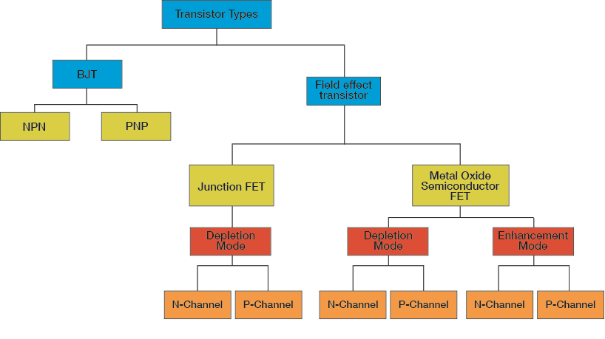
Classification of FET

Slide 4
Difference between BJT & FET
BJT
FET
Three terminal semiconductor device.
Emitter, base, collector
Current controlled device
Bipolar device
Two types- npn & pnp
Three terminal semiconductor device
Source, gate, drain
Voltage controlled device
Unipolar device
Two types – JFET & MOS FET

Slide 5


FET X BJT (NPN)
Drain
Collector
Gate
Base
Source
Emitter
FET
3 terminal device
Channel e⁻ current from source to drain controlled by the electric field generated by the gate
Extremely high input impedance for base
BJT
3 terminal device emitter to collector e⁻ current controlled by the current injected into the base
Notes:
There are many types of transistors in addition to the bipolar junction transistor (BJT) that we have discussed so far. An important class of 3 terminal transistors is the field effect devices. For these the control parameter is the electric field over the junction, as opposed to the current of the BJT. Since an electric field is associated with a voltage, the important advantage of the field effect devices is that there does not need to be a current into the control element (the gate). This results in a very high input impedance and a very low leakage current.
The easiest to understand are the junction field effect transistors (JFETs) which we will discuss first and in some detail. The metal oxide semiconductor FET (MOSFETs) are very important for digital logic implementations.

Slide 6
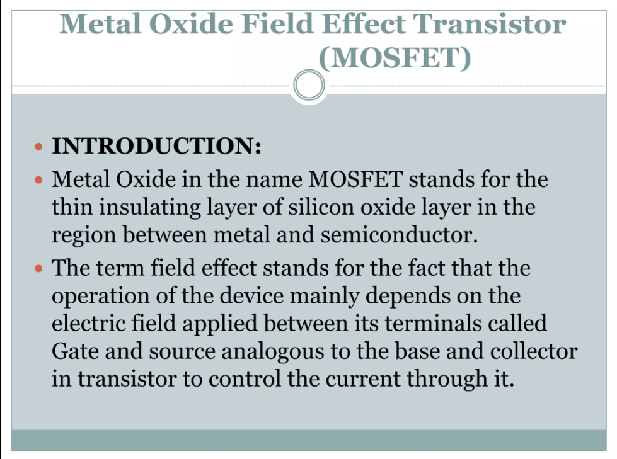

Slide 7
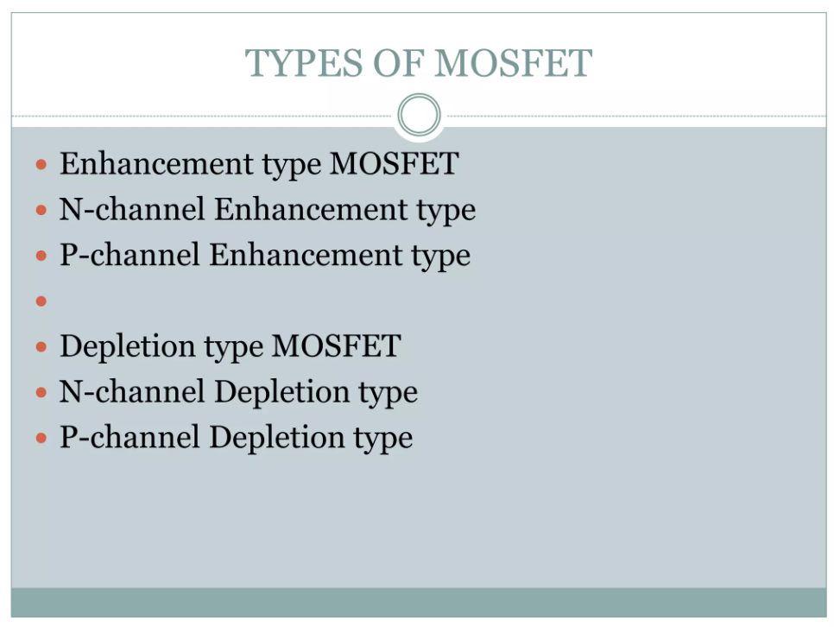

Slide 8
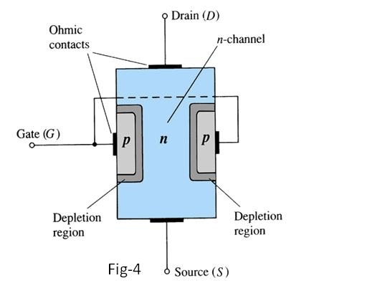
Construction of N-channel JFET
Major part of the structure is n- type meterial.
Top of the n-type channel Is connected through an ohmic contact to a terminal Reffered to as drain(D).
As lower end Connected through an ohmic contact to a terminal Reffered as source (S).
P-type meterials connected to gether and taken as terminal gate(G).
JFET has two pn junctions under no bias condition.

Slide 9
